Slide 1
The physical model & A cheating program of ddt
Um…I’m here to sell myself for a while…
Well,
Most of my work remains unknown to the outside world.
***********But today,***********
I’m going to reveal part of them,
Which is concerning about a game,
Together with a physical model built for it.
And then,
Things will get increasingly interesting,
For the next moment,
You’ll see a wonderful program I designed for this game.

Slide 2
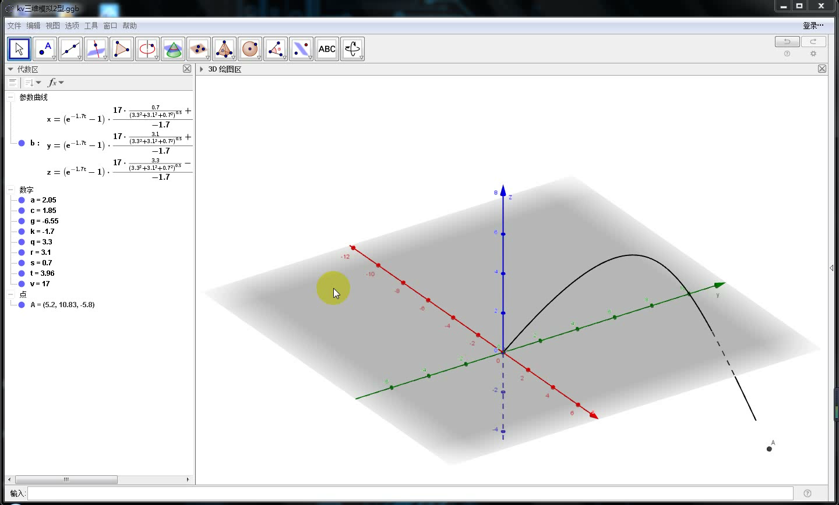
Technique + Knowledge = Technology, isn’t it?

Slide 3
Knowledge: in this section, it means the mathematical ways we adopt to help develop a physical model of DDT.
一.弹弹堂的物理模型的构建：
以人物的正面朝向为x轴正向，以-g方向为y轴正向，在这个坐标系下进行物理模型的建立：(注：在这样的坐标系下g为负数，而k恒为负数这个事实与坐标系的选择无关，它表示阻力加速度kv恒与v反向)。

Slide 4
I hope these words are informative enough for you guys…

Slide 5
I am truly complex to some extent, but I may prefer the word “organized”…

Slide 6
It’s hard to tell right from wrong, right?

Slide 7
This is more than my own truth, isn’t it?

Slide 8
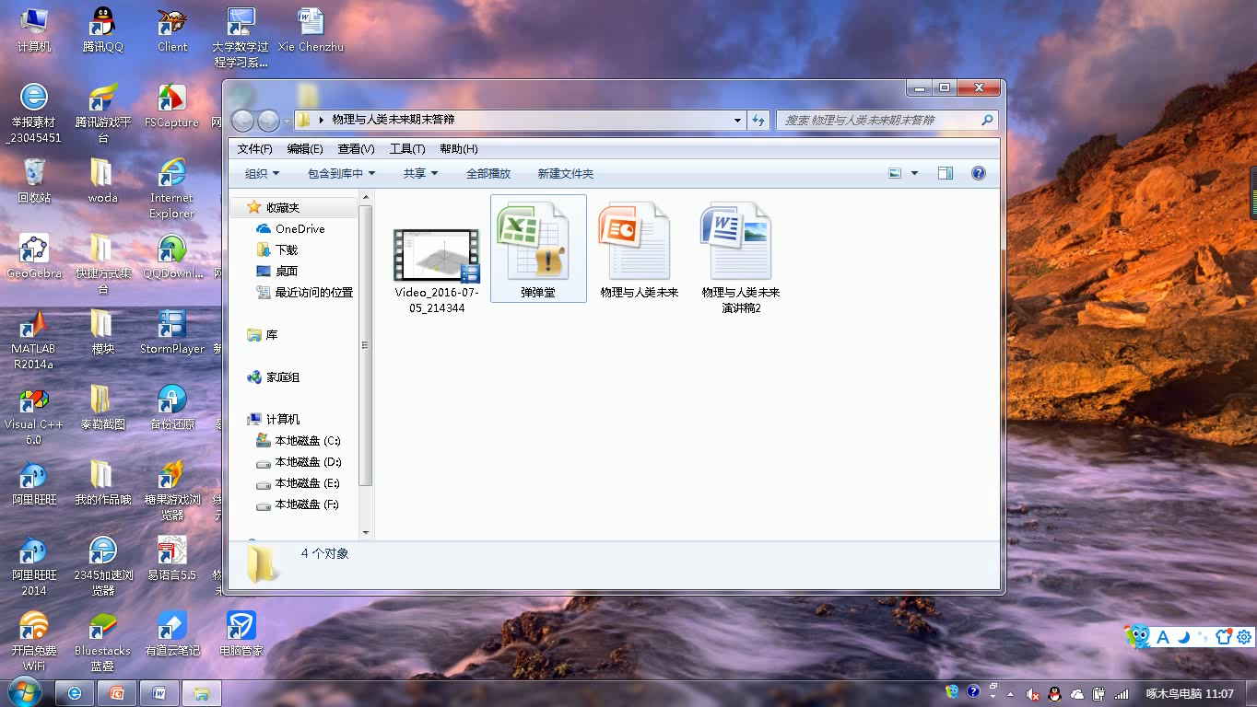
Technique: in this section, it means the programming skills we own to help generate a cheating program of DDT.

Slide 9

Any available sources at hand, I’ll take use of it.

Slide 10

I am both radical and rational.
But whatever,
I’ll show you how the universe works.
Here we go!!!
自制的弹弹堂辅助的实战视频：

Slide 11
It seems than you guys get so used to this world.
But,
Do you really?
I am aiming to eliminate the boundaries between your minds and mine
To achieve this goal, which will eventually lead to the smooth communication between us,
Let’s all unite!
And as you can see, the whole process is not at all an easy job,
But for every step, I do develop a suitable solution to settle it,
This means, sometimes what you really need is simply to have an ambition!
Or rather, just a dream!
********************
Thank you for listening!

